Slide 1
Employee Attrition: An Analysis
Presented by – Group 6
Pawale Krishna Balwant
Sooraj Sanjai
Sachin Santosh Gupta
S Renuka
Aayushi Wani
Kanchan Rai.

Slide 2
SQL

Slide 3
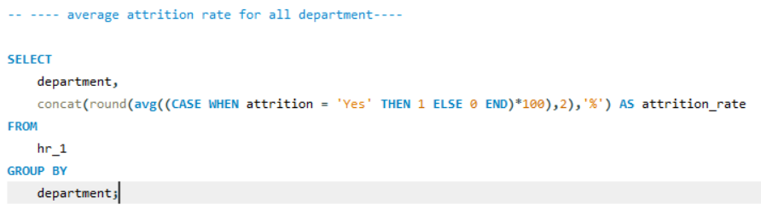
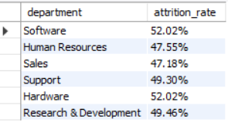
Q 1 Average Attrition rate for all Departments

Slide 4
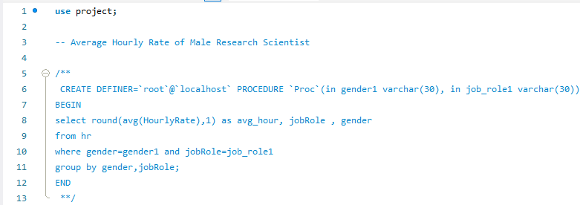

Q 2 Average Hourly Rate of Male Research Scientist

Slide 5
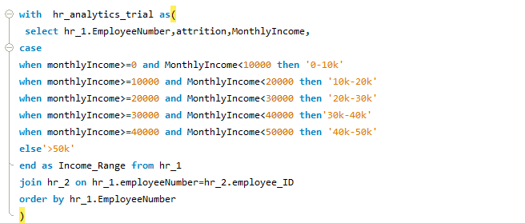
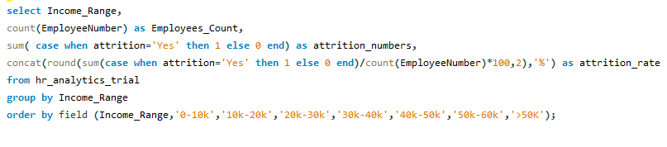
Q 3 Attrition rate Vs Monthly income stats

Slide 6
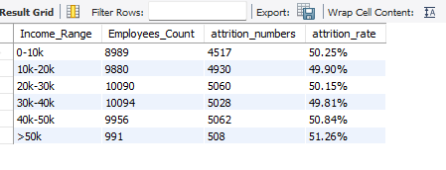
Q 3 Result

Slide 7

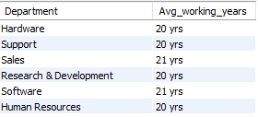
Q 4 - Average working years for each Department

Slide 8
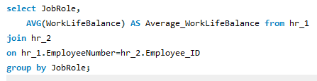
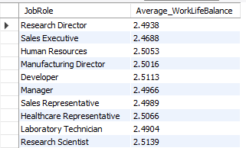
Q 5 - Job Role Vs Work life balance

Slide 9
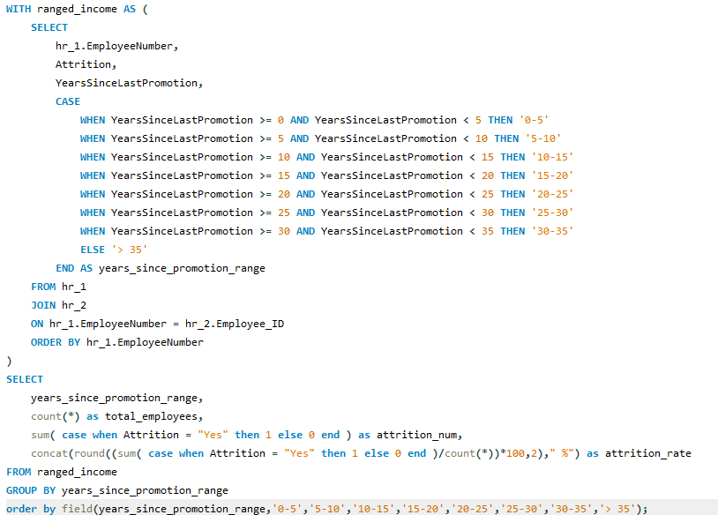
Q 6 - Attrition rate Vs Year since last promotion relation

Slide 10
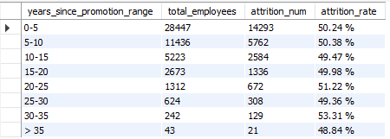
Q 6

Slide 11
Excel

Slide 12
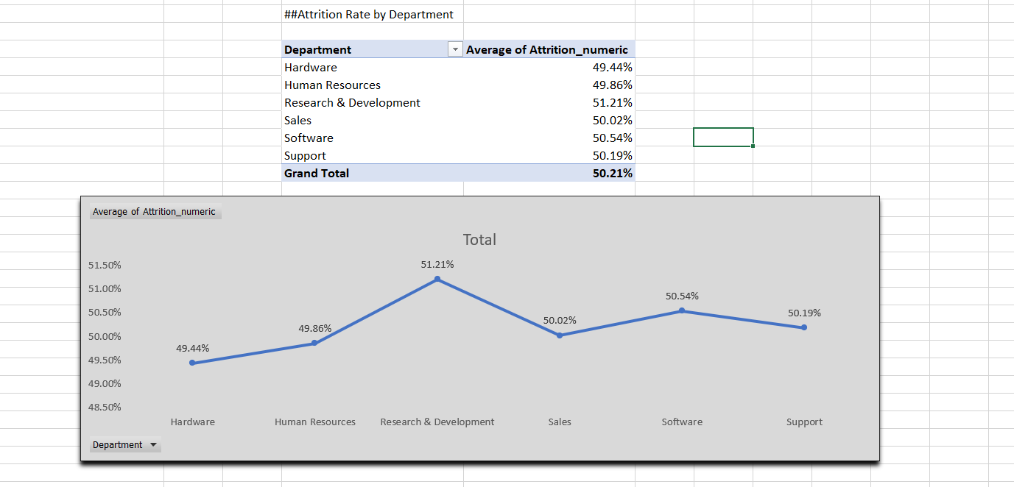
Q 1 Average Attrition rate for all Departments

Slide 13

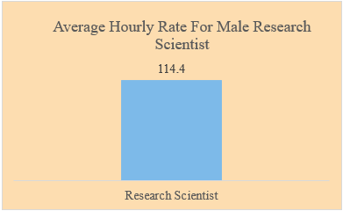
Q 2 Average Hourly Rate of Male Research Scientist

Slide 14
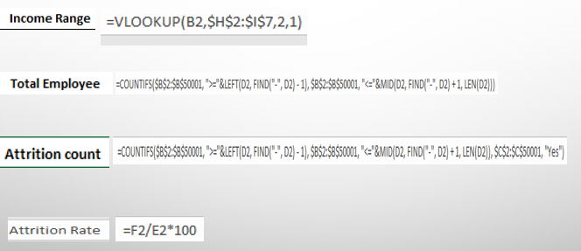
Q 3 Attrition rate Vs Monthly income stats

Slide 15
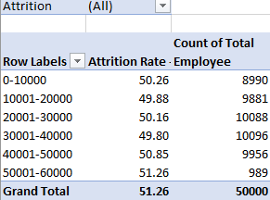
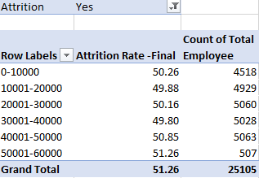
Q 3 Attrition rate Vs Monthly income stats

Slide 16
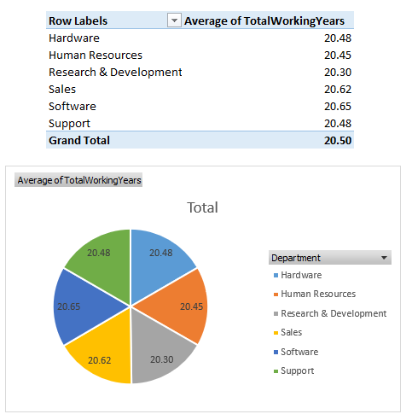
Q 4 - Average working years for each Department

Slide 17
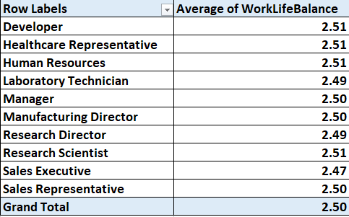
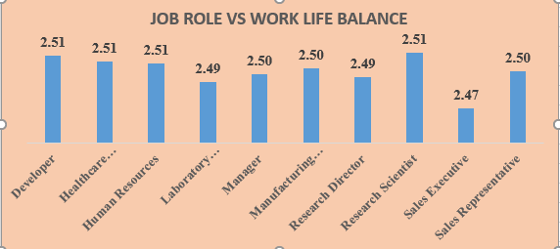
Q 5 - Job Role Vs Work life balance

Slide 18
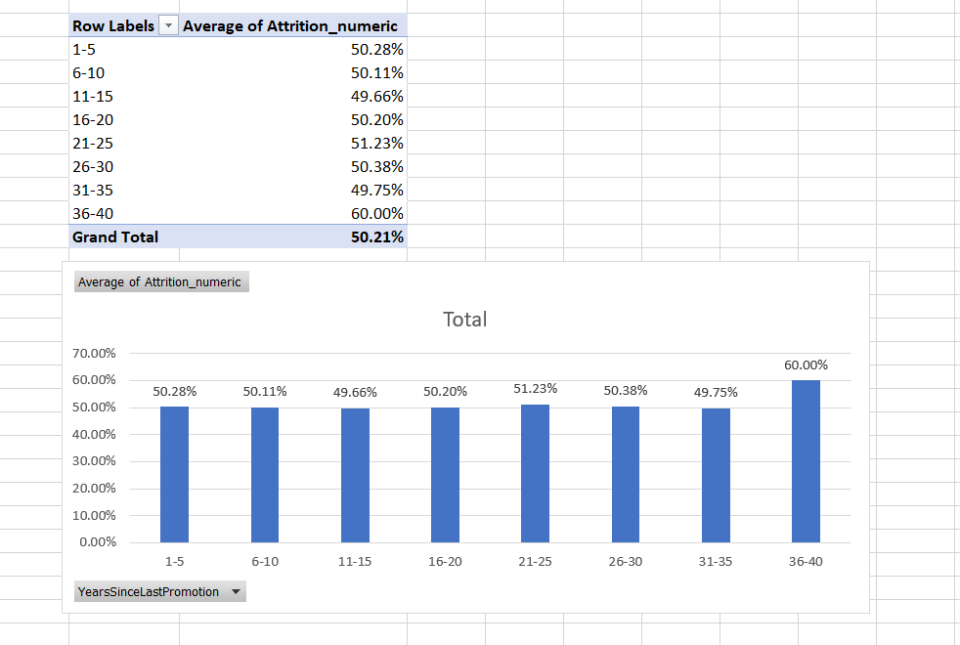
Q 6 - Attrition rate Vs Year since last promotion relation

Slide 19
Power BI

Slide 20
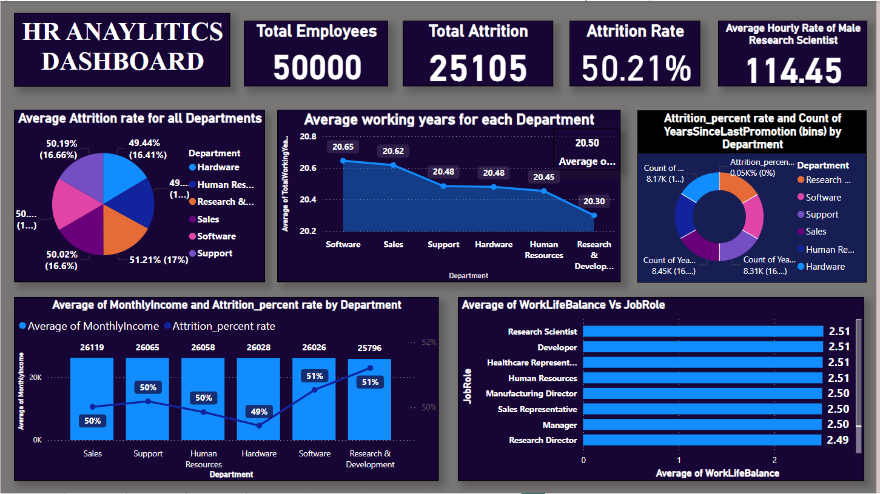
Dashboard

Slide 21
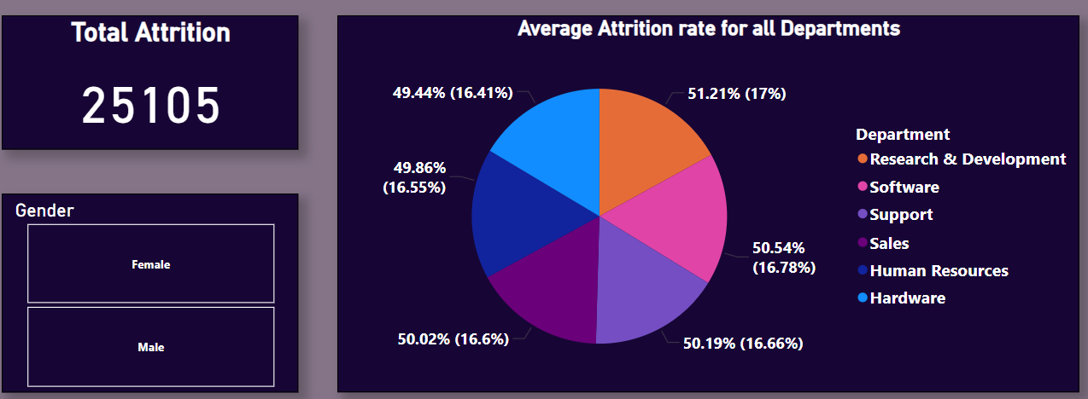
Q 1 Average Attrition rate for all Departments

Slide 22
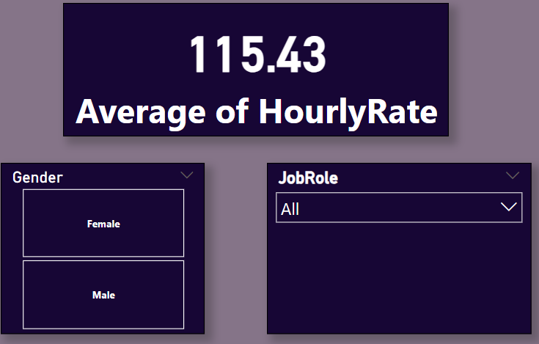
Q 2 Average Hourly Rate of Male Research Scientist

Slide 23
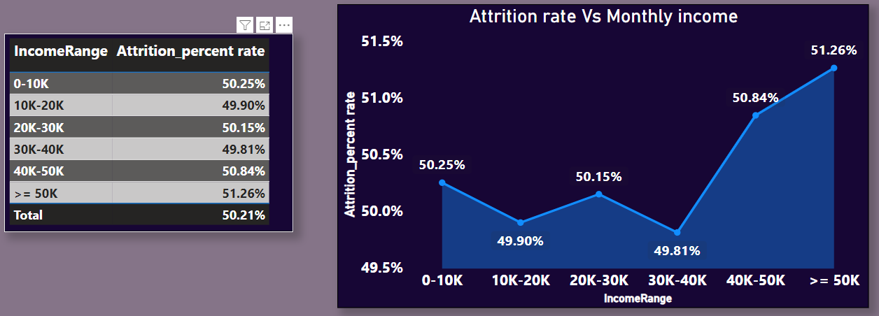
Q 3 Attrition rate Vs Monthly income stats

Slide 24
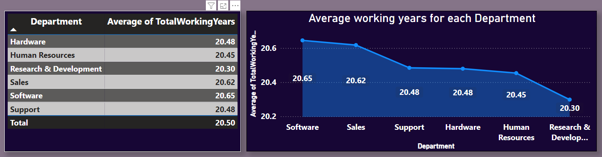
Q 4 - Average working years for each Department

Slide 25
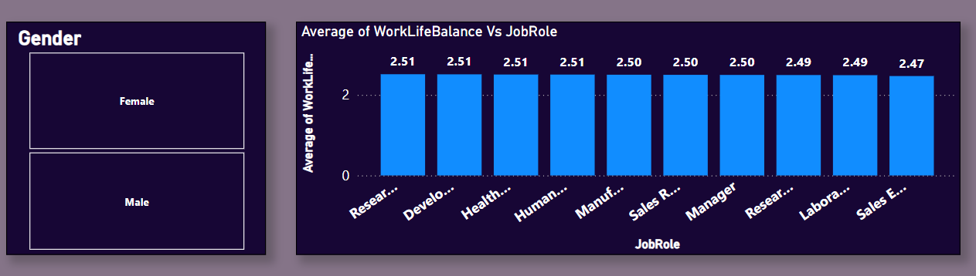
Q 5 - Job Role Vs Work life balance

Slide 26
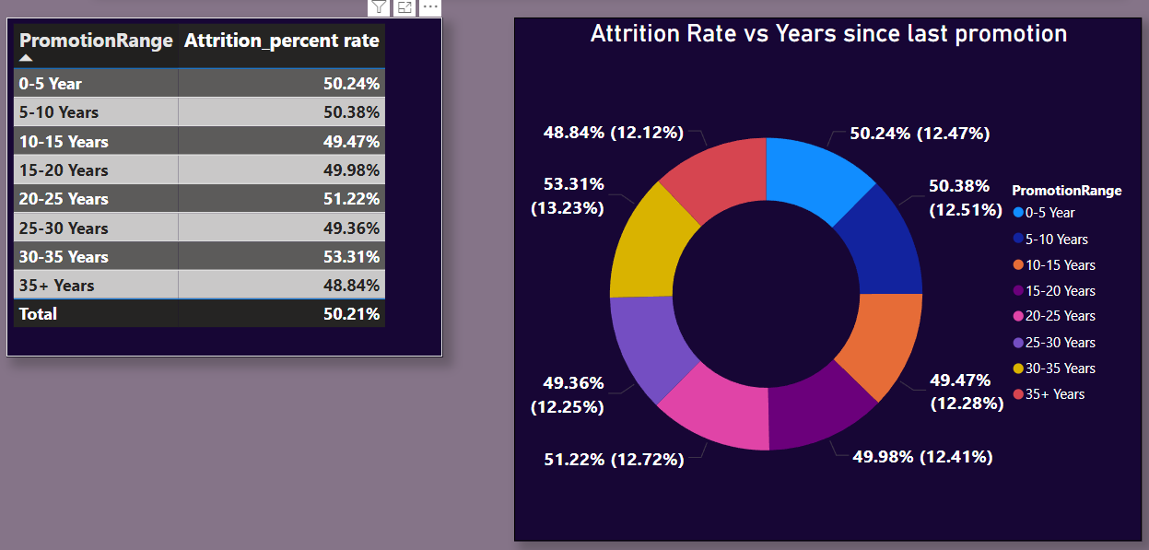
Q 6 - Attrition rate Vs Year since last promotion relation

Slide 27
Tableau

Slide 28
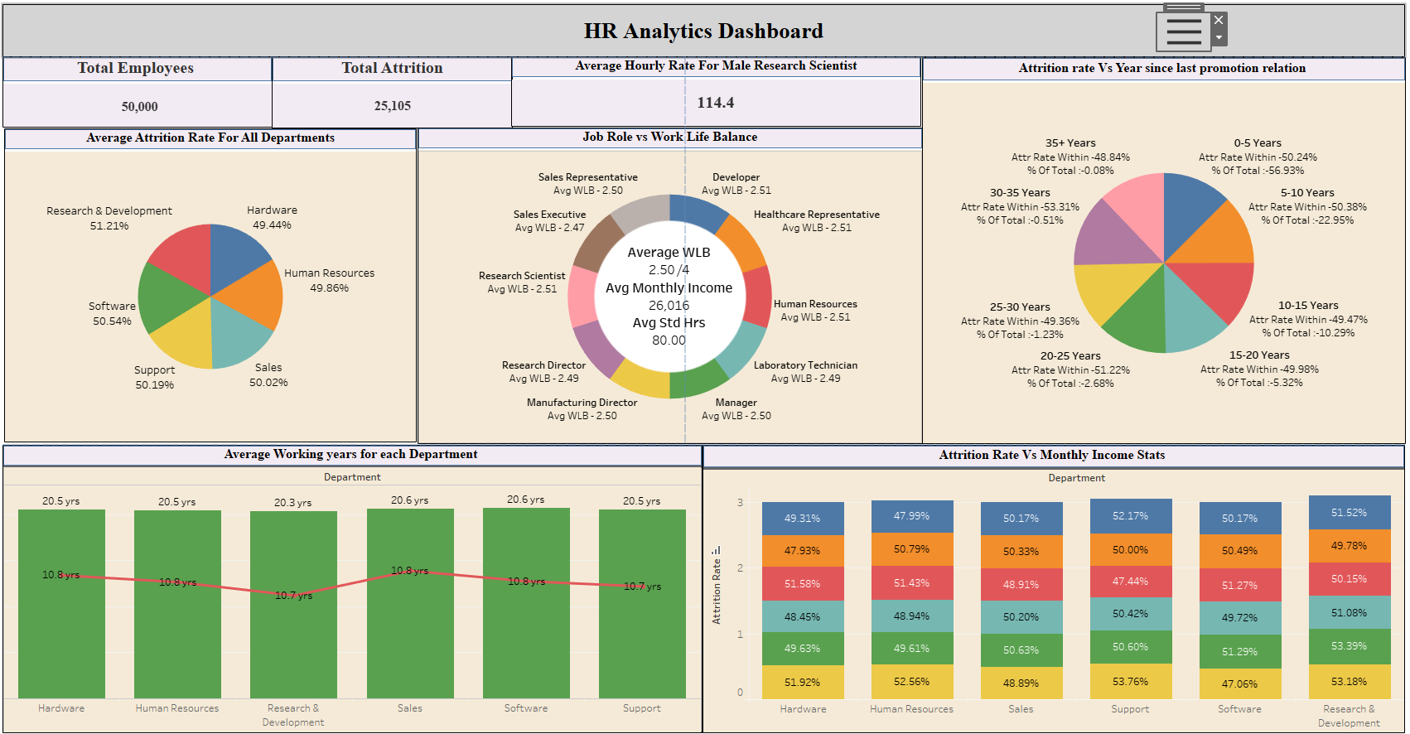
Dashboard

Slide 29
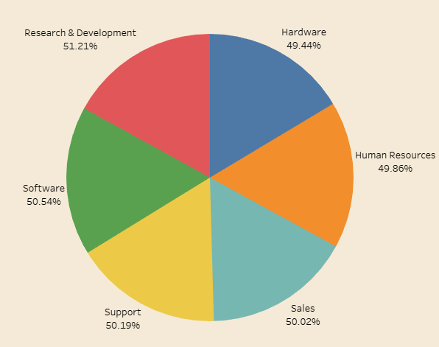
Q 1 Average Attrition rate for all Departments

Slide 30
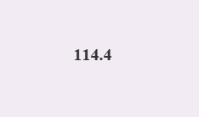
Q 2 Average Hourly Rate of Male Research Scientist

Slide 31
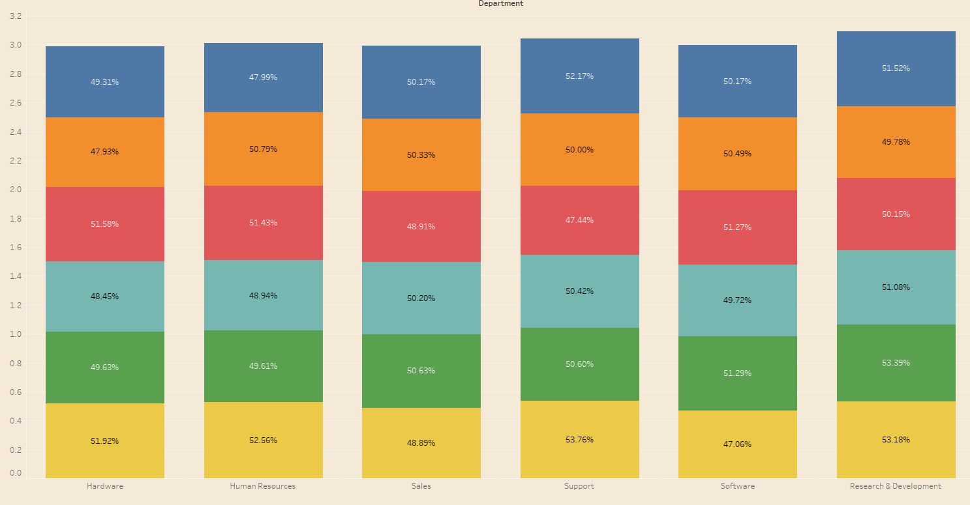
Q 3 Attrition rate Vs Monthly income stats

Slide 32
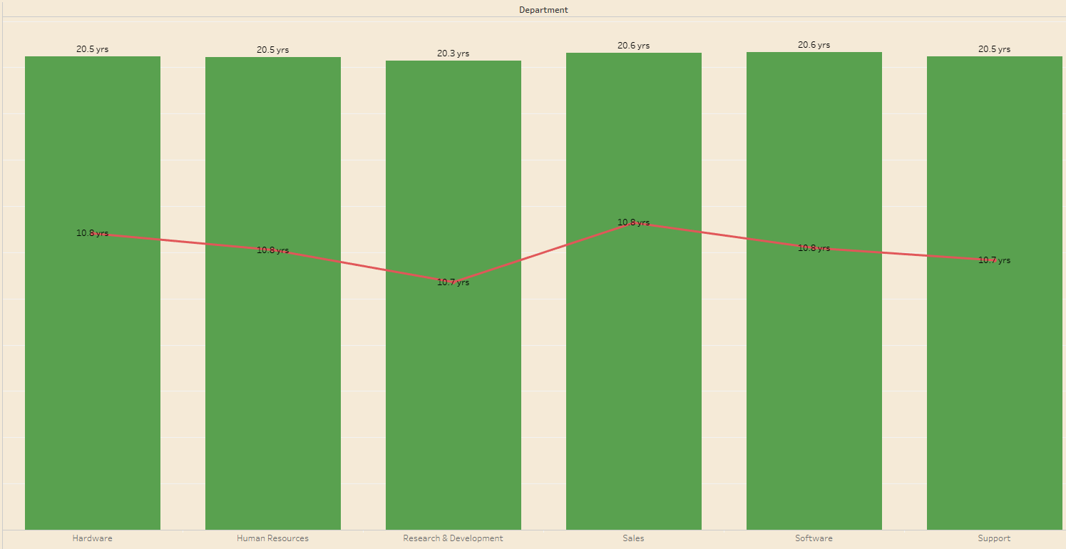
Q 4 - Average working years for each Department

Slide 33
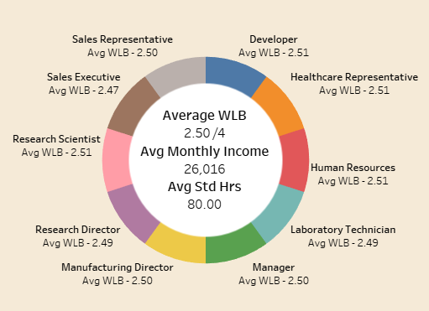
Q 5 - Job Role Vs Work life balance

Slide 34
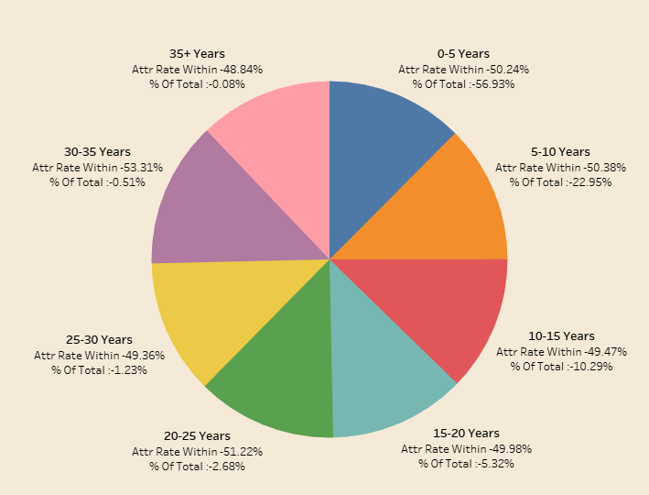
Q 6 - Attrition rate Vs Year since last promotion relation

Slide 35
Conclusions and Recommendations

Slide 36
Conclusions
- KPI 1 [ Average attrition rate for all departments ] = The attrition rates across all departments are almost consistent throughout, hovering around the 50% mark. Research and Development might need some attention given they have the highest attrition rates.
- KPI 2 [ Average hourly rate for Male Research Scientist ] = The average hourly rate for a male research scientist is 114.4.
- KPI 3 [ Attrition rate vs Monthly Income Stats ] = The attrition rate does not vary significantly across different income ranges, staying around 50% around the overall rate. Higher income does not necessarily lead to lower attrition; in fact, the highest income range (>= $50K) has the highest attrition rate. The lowest attrition rates are found in the middle-income ranges ($10K-$20K and $30K-$40K), suggesting that extreme ends of the income spectrum might be more prone to attrition.
- KPI 4 [ Average Working years for each Department ] = The average total working years across different departments are quite close, indicating a relatively uniform experience level among employees across the organization.
- KPI 5 [ Job Role vs Work Life Balance] = The work life balance values across all departments are quite good with average values hovering close to 2.5 out of a ranking of 4.
- KPI 6 [ Attrition rate vs Years since last promotion] = Within each department, the attrition rate hovers around 50%. But if we were to consider how much each department contributes to the overall attrition rate; then we can see that the younger talent (those who haven’t been promoted since 0-5 years) contribute the highest to the overall attrition count.

Slide 37
Recommendations
- Specific attention is needed for the Research & Development department, which has the highest attrition rate. This may involve deeper investigation into department-specific challenges, such as job satisfaction, work environment, and career advancement opportunities.
- The consistent average total working years across departments indicate a uniform level of experience among employees across all departments. This consistency provides a strong foundation for cross-departmental training and development programs, which can be leveraged to enhance employee satisfaction and reduce attrition.
- The generally good work-life balance scores (around 2.5 out of 4) suggest that the organization is performing well in this area. However, continuous monitoring and improvement of work-life balance policies will be essential to maintain this positive trend and further reduce attrition rates.

Slide 38
Recommendations
- Younger employees and those who have not been promoted within the last 0-5 years are contributing significantly to the overall attrition rate. Additionally, the presence of employees who haven't received promotions in over 20+ years is a statistic that warrants attention. This underscores the need for targeted engagement strategies for all employees. Implementing mentorship programs, fast-track career paths, and regular feedback mechanisms can help retain the critical segment of young talent. For the senior employees, it is crucial to ensure that, despite the lack of recent promotions, they remain satisfied in their roles and are adequately compensated, considering their extensive experience.
- The data underscores the importance of a holistic approach to retention that encompasses financial rewards, career development, recognition, and work-life balance. Ensuring that all these aspects are addressed will likely result in a more satisfied and committed workforce, thereby reducing overall attrition rates.

Slide 39
Recommendations
- Conduct Exit Interviews: To gain deeper insights into why employees leave, especially those in high-attrition departments and income brackets.
- Enhance Career Development Programs: Focus on creating more opportunities for promotions and professional growth within the organization.
- Regular Reviews of Compensation Packages: Ensure that salary and benefits remain competitive but are also coupled with non-monetary rewards.
- Employee Engagement Surveys: Regularly assess employee satisfaction and engagement to identify potential issues early and address them proactively.

Slide 40
Thank You!

